Slide 1

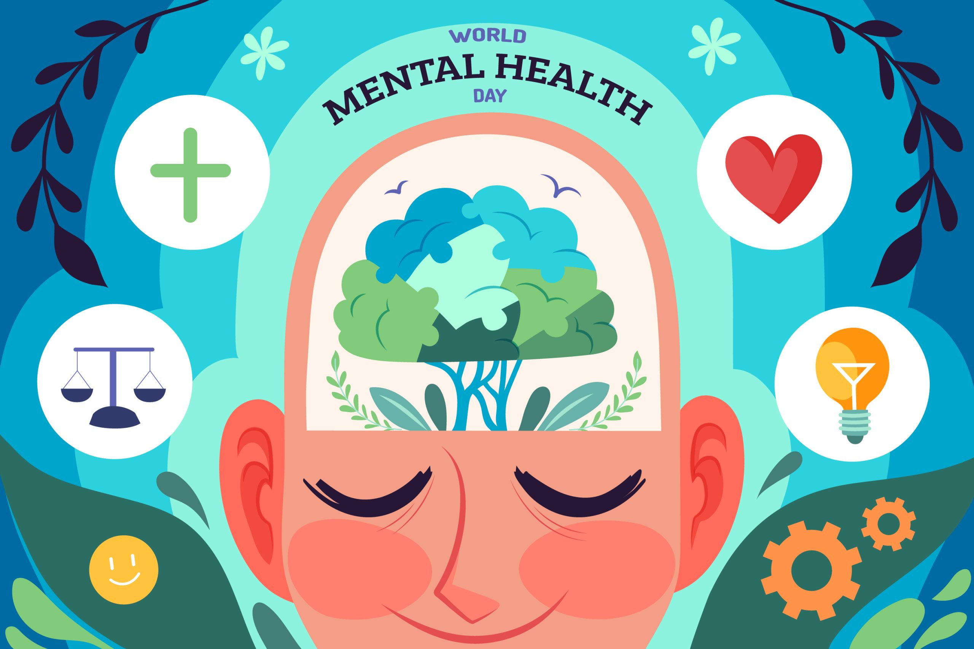
Mental health
What you feel

Slide 2
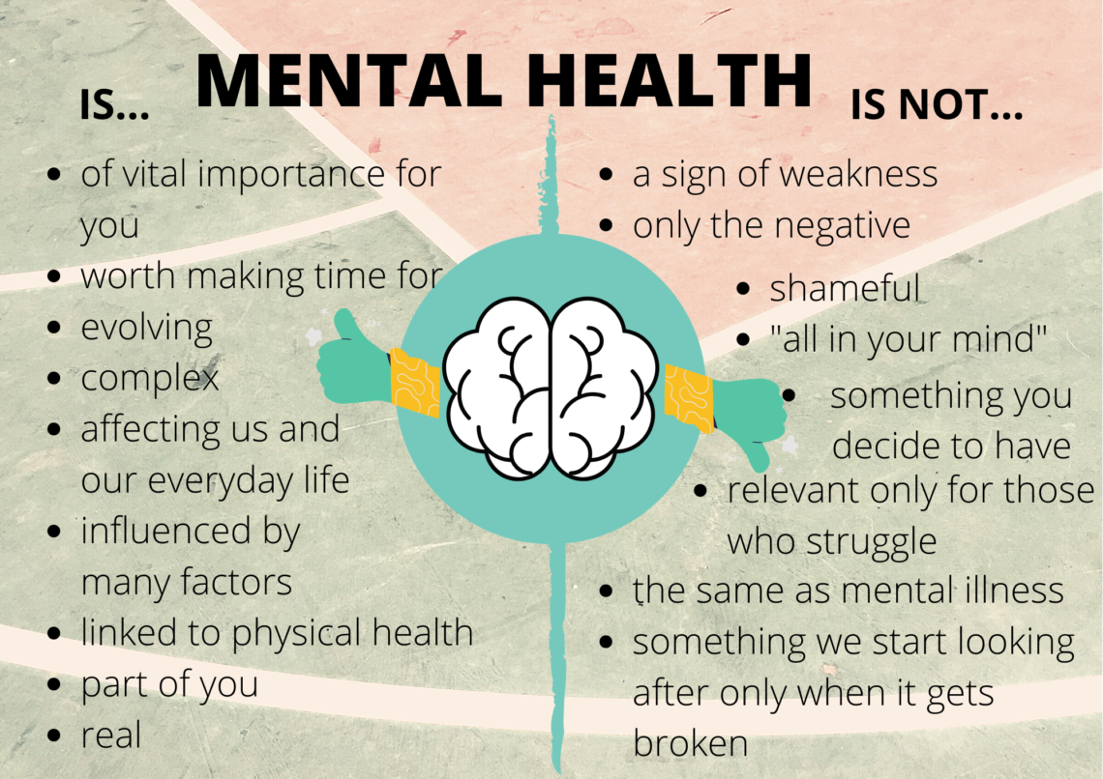
What is mental health?
Mental health is how you feel, so if you feel sad, at that time your mental health would be bad and if you feel happy your mental health will be good at that moment.

Slide 3
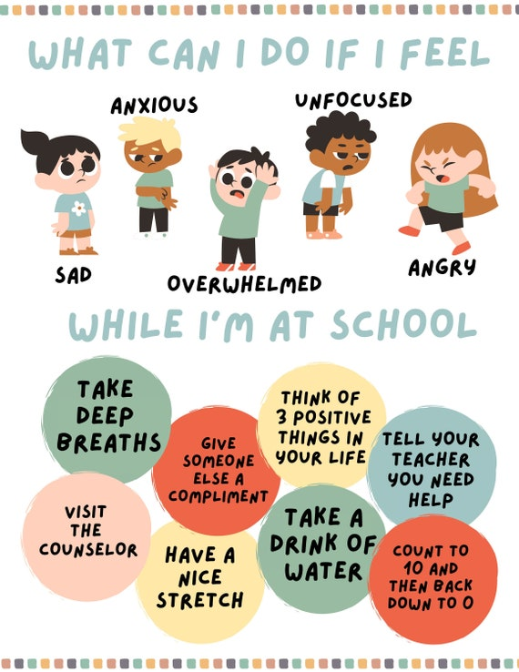
People to help you
Trusted adults: mum dad teacher brother sister profesionals
Friends can also help
Child line: 0800 1111 or visit their website

Slide 4
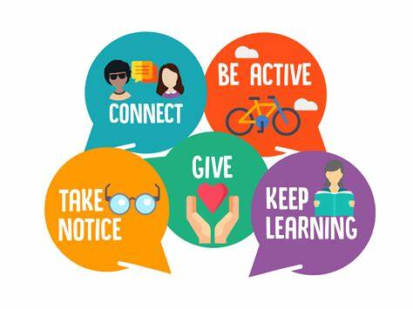
Ways to have good mental health
.do things you like
.take time to relax
.if you have a bad day talk about it
.be kind
.feel good about your self

Slide 5
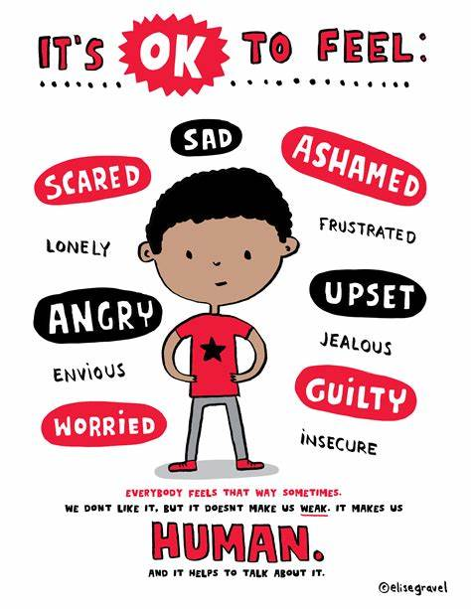
Ok emotions

Slide 6
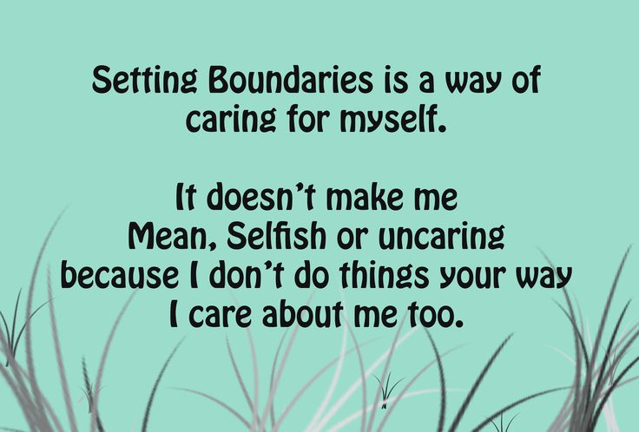
Setting boundaries
It is ok to set boundaries .
Where do I need to set
Boundaries?
It is ok to say no
And not agree
Nobody has to agree with you
It is ok to feel emotions
You don’t have to fix others’ problems is it doesn’t include something I have done.

